Slide 1

COVID-19 Benefit
---Mac BoYs

Slide 2
CONTENTS
01
Background
02
Results
03
Discussion
04
Conclusion

Slide 3
Background
2020 is an unusual year. The COVID-19 pandemic has changed the political and economic landscape of the entire world. Many people face financial hardship as a result of the public health measures necessary to contain the spread of COVID-19. Revenue Canada (CRA) administers the COVID-19 Temporary Relief Benefit Program to help Canada and Canadian businesses affected by the outbreak. From a social perspective, many Canadians and Canadian businesses rely heavily on these welfare programs.

Slide 4
Results
CRB & GDP
Wage Subsidy
CESB & Unemployment
Inflation Rate & Social Benefit Programs

Slide 5
CRB Gross Amount& GDP
Most the provinces and territories which have the most COVID cases also accompany with the large amount of CRB .
The GDP amount remains in a relative high-level in this regions with high infection cases but also high CRB gross amount.
* CRB: The Canada Recovery Benefit. Income supporting for employed and self-employed individuals who are directly affected by COVID-19.
* Data collected from Oct.2020- Oct.2021

Slide 6
CESB & Unemployment
Generally, the unemployment in the group of age over 25 across the country decrease since Oct. 2020.
The CESB financial support is not highly related in alleviate the unemployment in the group of age 25+ population.
* CESB: The Canada Emergency Student Benefit supporting post-secondary and high school graduates who are unable to find work due to COVID-19.
* Data collected from Oct.2020- Oct.2021

Slide 7
CESB & Unemployment
In comparison, the unemployment in the group of age between 15-24 old decrease significantly since Oct. 2020.
The CESB financial support seems have strong connection for reducing the unemployment in the group of 15-24 years old population.
* CESB: The Canada Emergency Student Benefit supporting post-secondary and high school graduates who are unable to find work due to COVID-19.
* Data collected from Oct.2020- Oct.2021

Slide 8
Discussion --Wage Subsidy
CPI? Market Price? OR...?
* Canada Emergency Wage Subsidy (CEWS) beginning in April 2020.
* Data collected from April 2020 to December 2020.

Slide 9
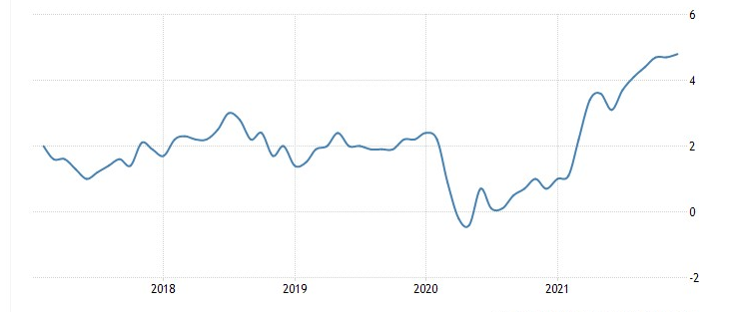
Discussion -- Inflation Rate
The inflation rate due to the pandemic of covid 19
The inflation rate increased significantly than previous years.
Last time we have situation like this is after 2008 financial crisis. Because economy is starting recover.
* There are many reason can cause this and we need the more time to discover the relationship between inflation and pandemic.

Slide 10
Conclusion
CRB program might connected to GDP mantaining, it gives support to the individuals or small businesses who cannot survive the lockdown or other extreme events.
The CESB program alleviate the unemployment rate in the group of people who are 15-24 years old, but not obivious in the 25+ group people.
The continously growing inflation rate could be the result of benefit program due to the government increase the amount of currency in the market.

Slide 11
Citation
https://open.canada.ca/data/en/dataset/b1585ce0-765a-4ab9-ac82-e8255c3b6c7b
https://open.canada.ca/data/en/dataset/f713389f-ab1c-4be4-bade-05f71ed110fe
https://open.canada.ca/data/en/dataset/dd09b357-79b1-444b-8503-37b7eb244a1e
Statistics Canada. Table 14-10-0287-03 Labour force characteristics by province, monthly, seasonally adjusted.DOI: https://doi.org/10.25318/1410028701-eng

Slide 12
THANK YOU

